Slide 1
Do conflicts exist between micro and macroevolution? If so, what are they? pollev.com/josefuyeda941

Slide 2
The other side of the coin...Stasis
“Stasis is data”
Microevolutionary theory can explain punctuations, but can it explain stasis?

Slide 3
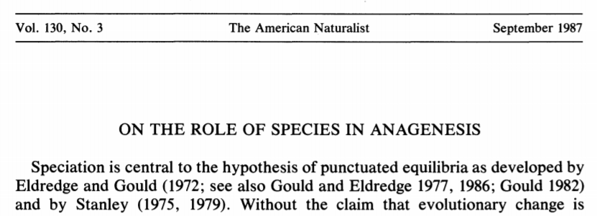

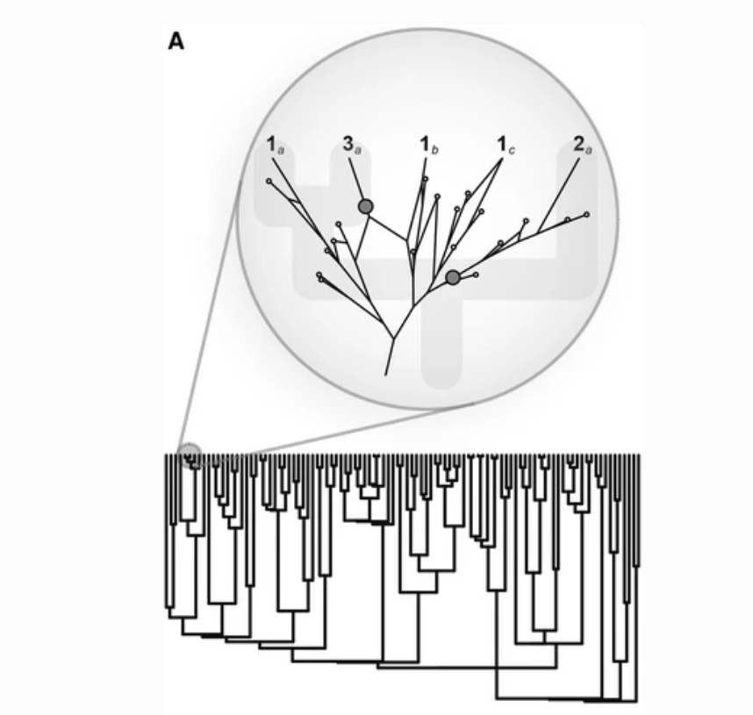
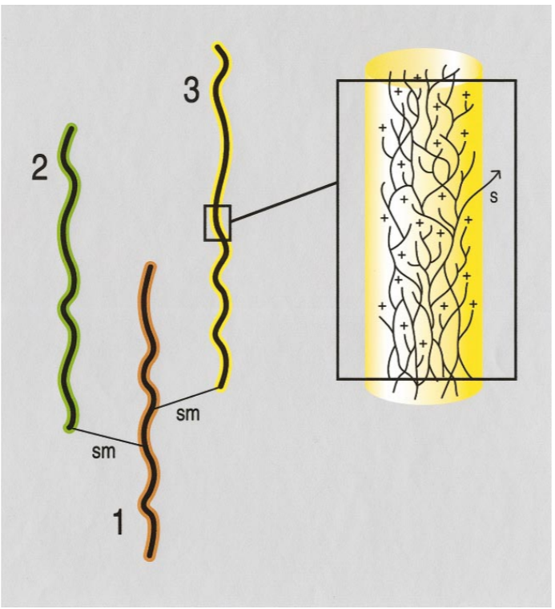
Ephemeral divergence model
Doug Futuyma
related: Ephemeral
speciation

Slide 4
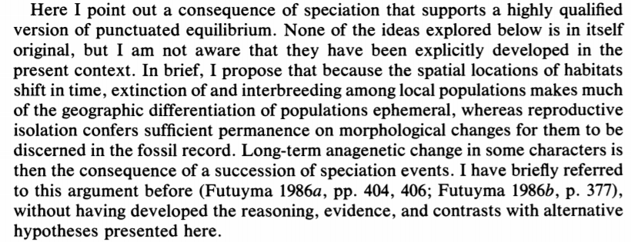
Rescued version of PE?

Slide 5
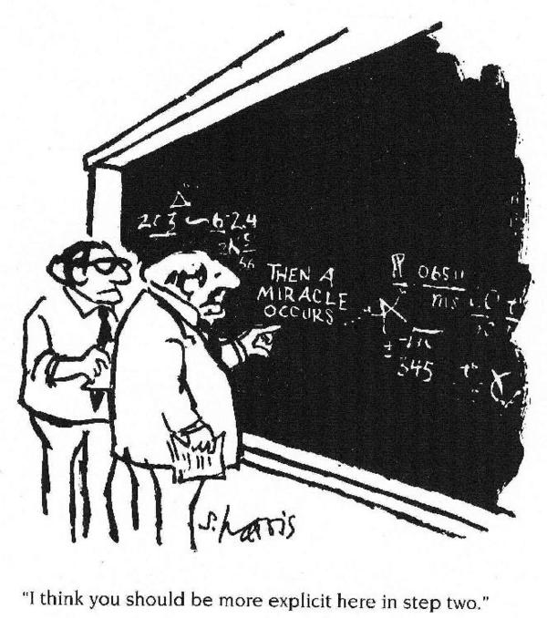
Microevolution
Macroevolution
Notes:
But this is only a hypothesis. Few have actually explicitly compared microevolutionary and macroevolutionary data to determine whether they are consistent with each other. Are they really compatible?

Slide 6
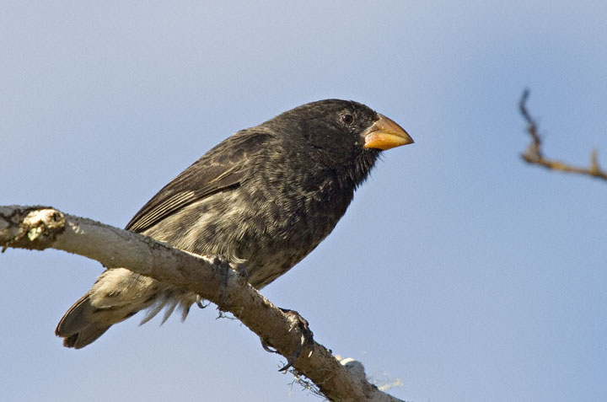
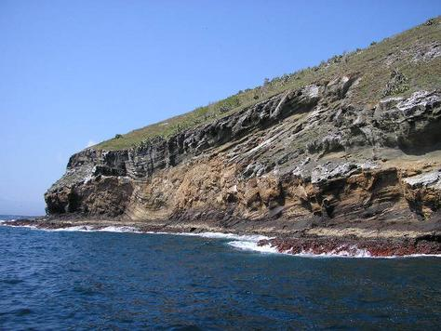
Microevolutionary patterns
We now know that we can study evolution in real time
Average weight
16.06 g
(1976)
17.13 g
(1978)
Response to selection
6.7% ∆ body size in
1 generation
(2 years)
Let’s assume only 1% is evolutionary
(Grant and Grant, 2002)

Slide 8
Let’s do the calculations:
If a population increased by 1% every generation starting from ~16 g:
In 200 years
43 g
In 500 years
193 g
In 1,000 years
2.3 kg
In 2,000 years
335 kg
In 10,000 years
6.47 x 10¹⁹ kg

Slide 9
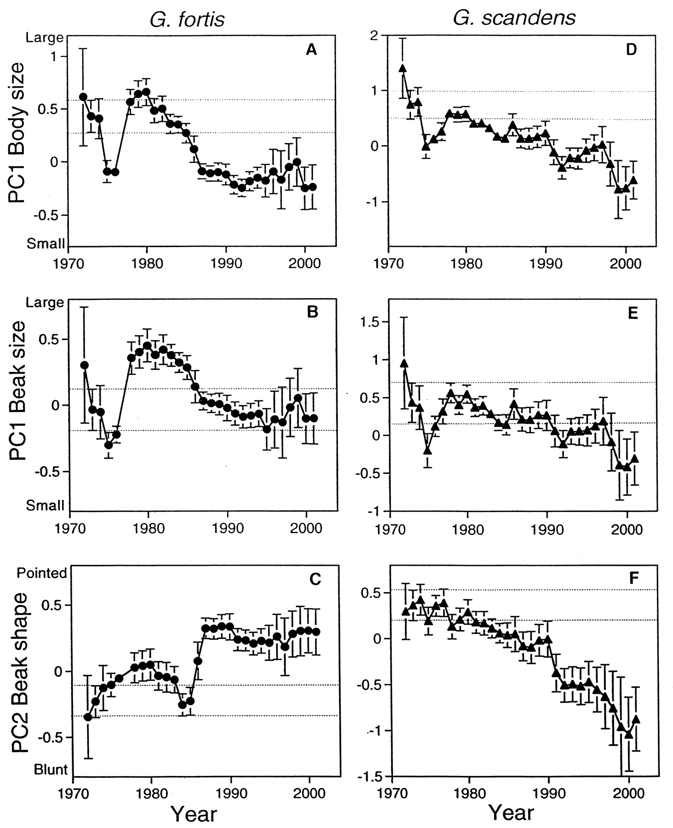
But evolution often reverses itself!
Let’s instead simulate BM
(Grant and Grant, 2002)

Slide 10
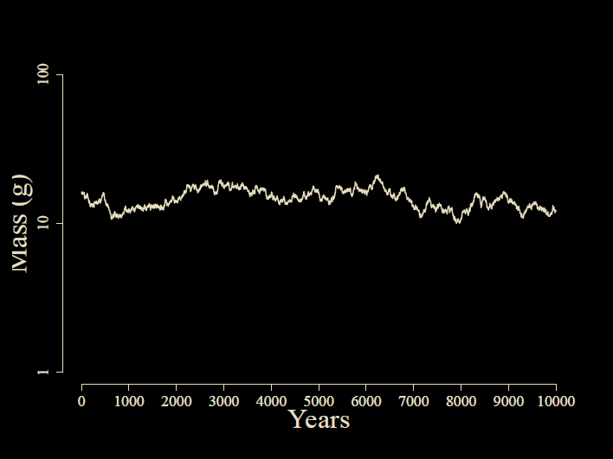
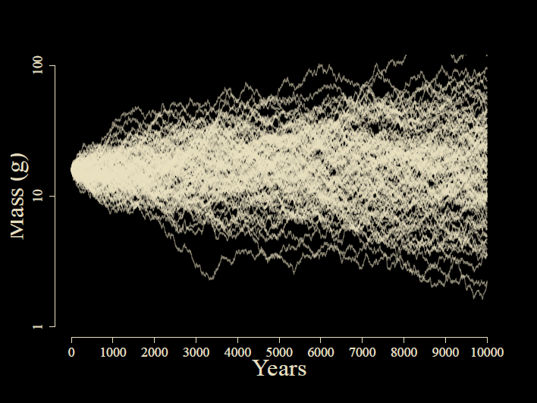
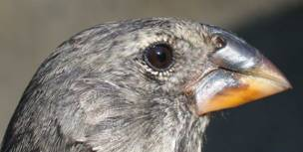

Slide 11
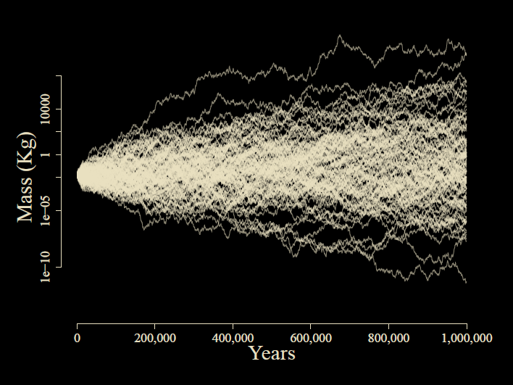

Slide 12

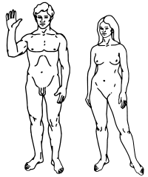

Slide 13
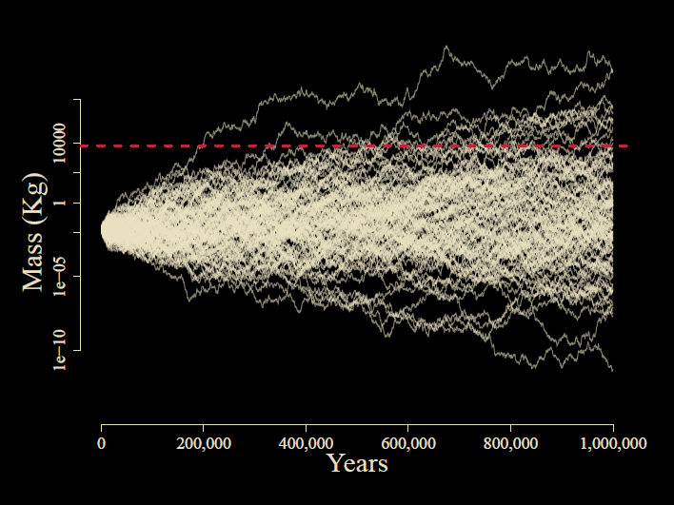

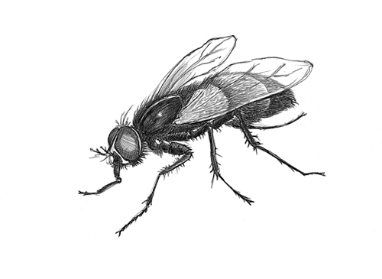

Slide 14
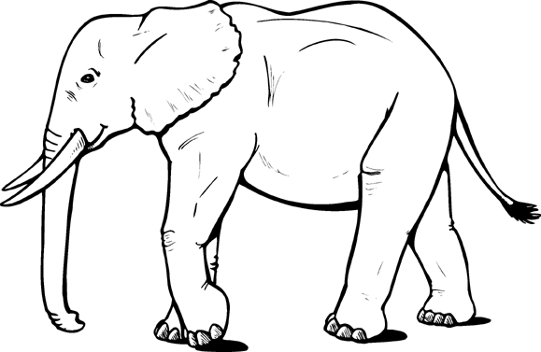

Slide 15
The Breeder’s Equation
Δz = V_{G}*β
Response to selection
Genetic variance for trait
Selection gradient (slope of adaptive landscape)

Slide 16
Genetic Drift (BM)
Δz = sqrt(V_{G}/Ne) * dW

Slide 17
Both processes together (OU)
Δz = V_{G}β + sqrt(V_{G}/Ne) dW

Slide 18
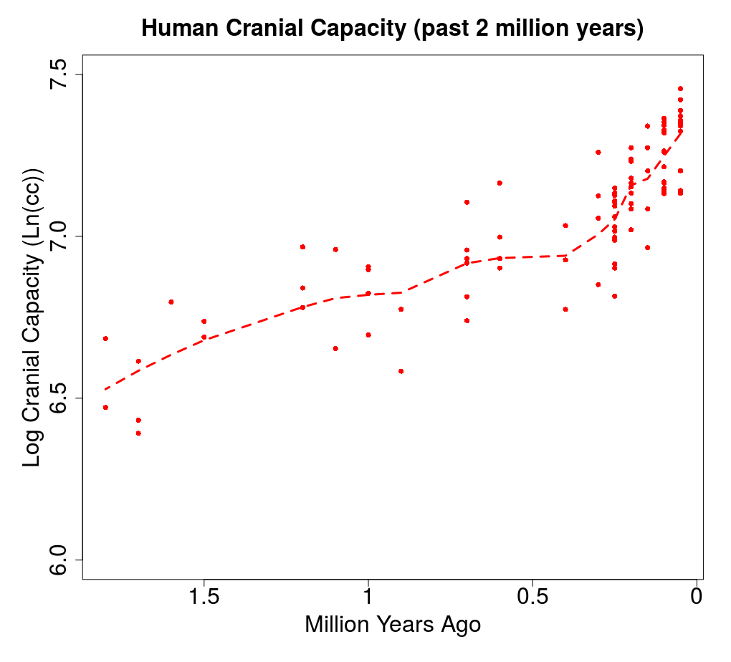

Slide 19
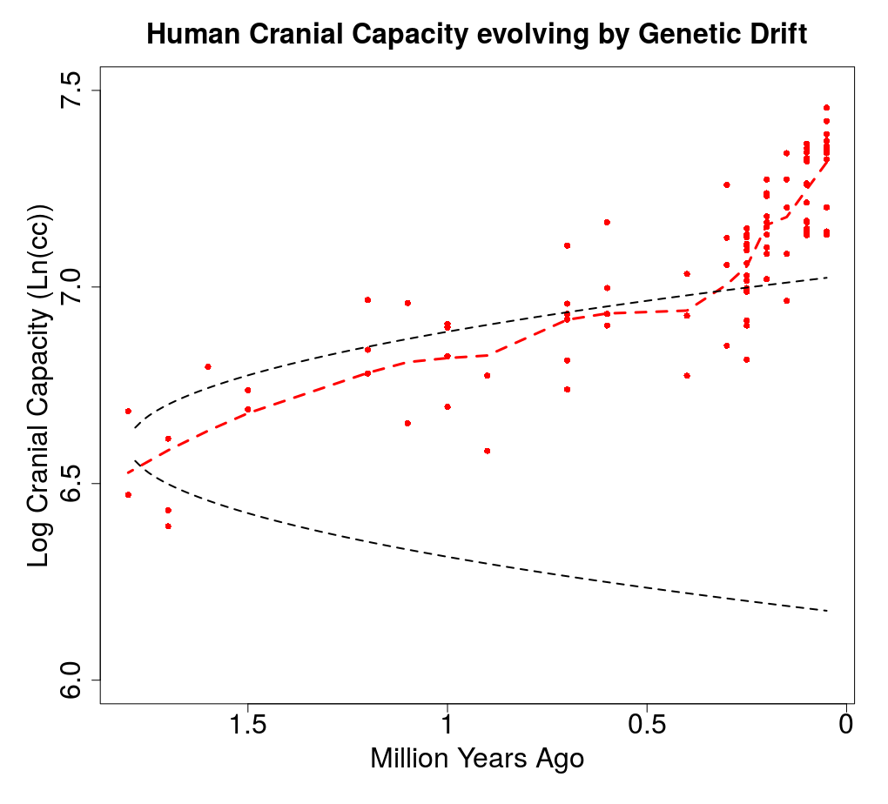

Slide 20
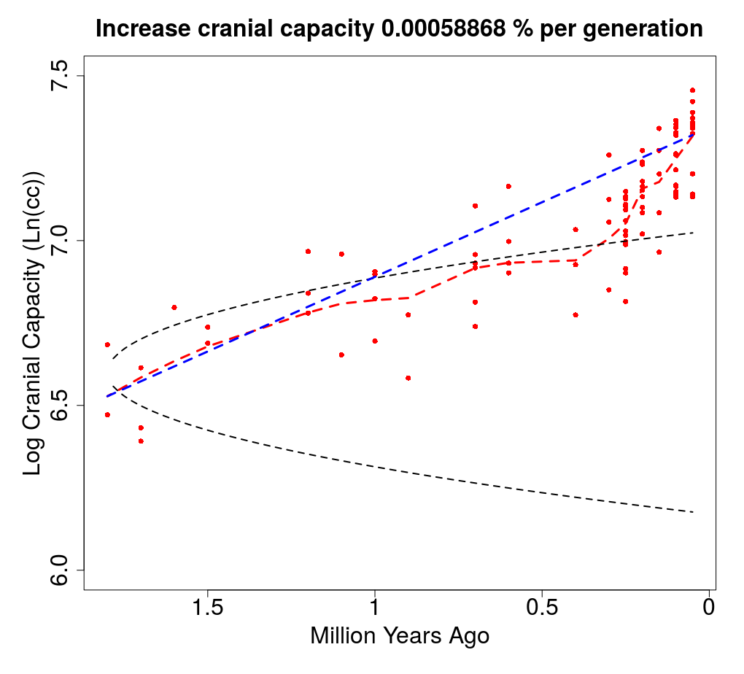

Slide 22
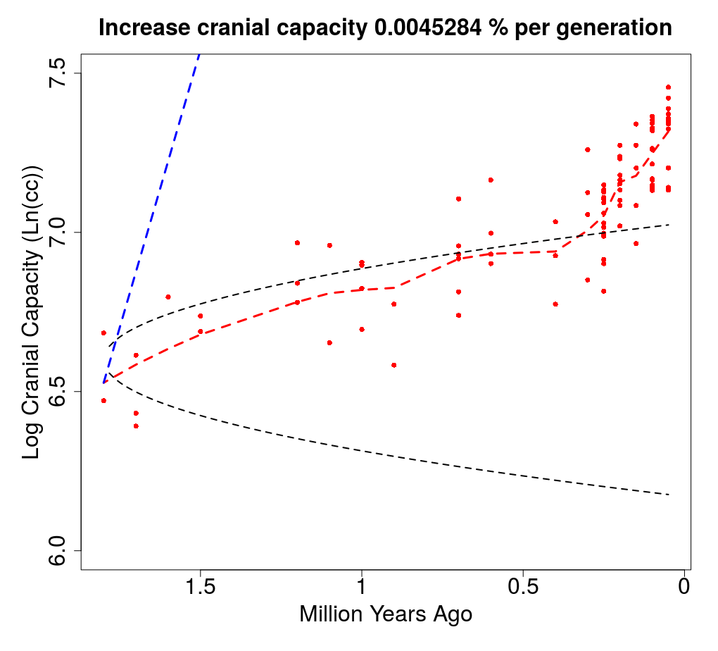

Slide 23
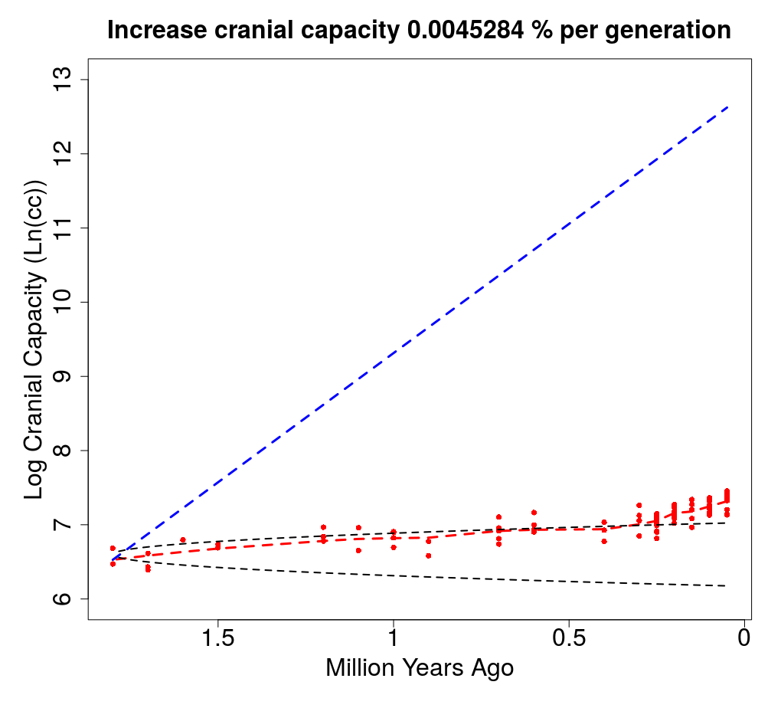


Slide 24
The Paradox of Stasis (Hansen & Houle 2004): Organisms seem to be able to evolve far more than they ever do
Empirical studies often find:
Strong (and often persistent) directional selection
(Hereford et al. 2004, Morrissey & Hadfield 2012)
High levels of additive genetic variance
(Mousseau & Roff 1987, Houle 1992)
Rapid evolutionary rates
(Hendry & Kinnison 1999, Kinnison & Hendry 2002)
…yet stasis in the fossil record
(Gingerich 1983, 2002)
Notes:
Perhaps headlines from Kingsolver’s paper?

Slide 25
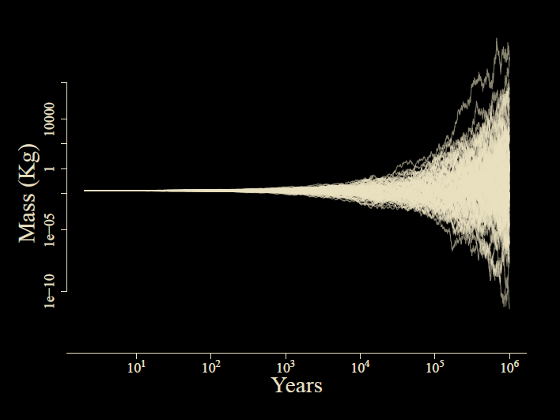

Slide 26
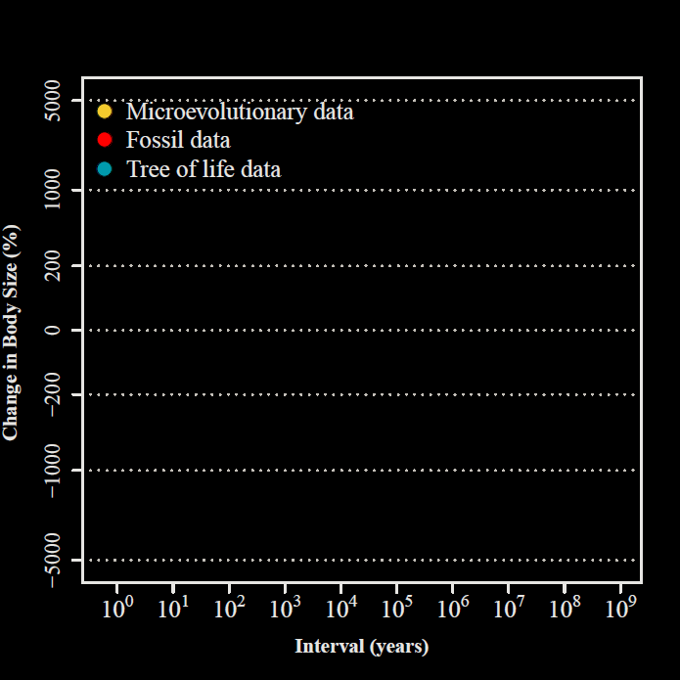
Uyeda et al.,
PNAS, 2011

Slide 27
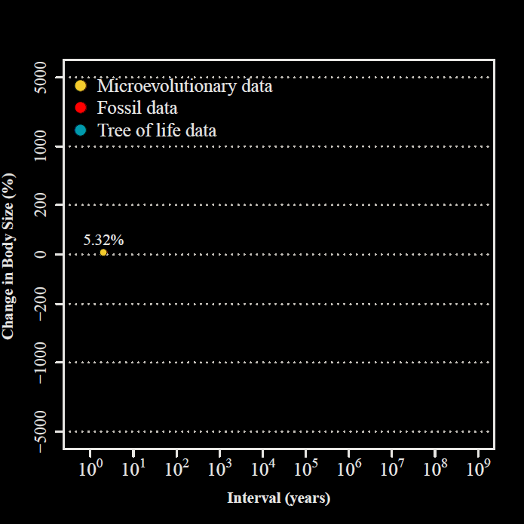
2 years
Uyeda et al.,
PNAS, 2011

Slide 28
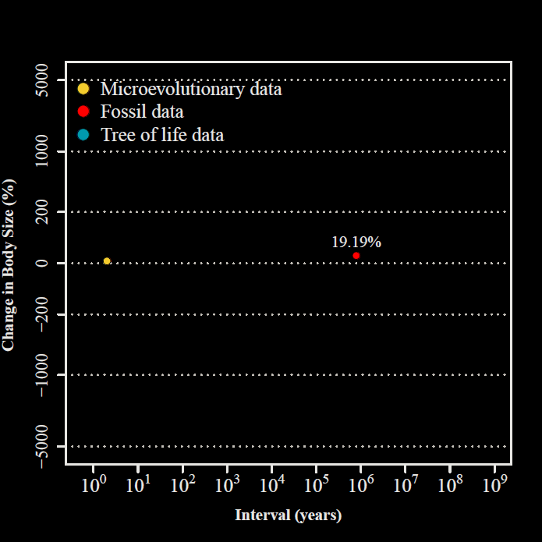
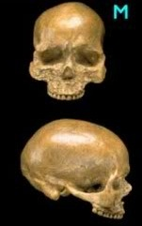
800,000 years
Uyeda et al.,
PNAS, 2011

Slide 29
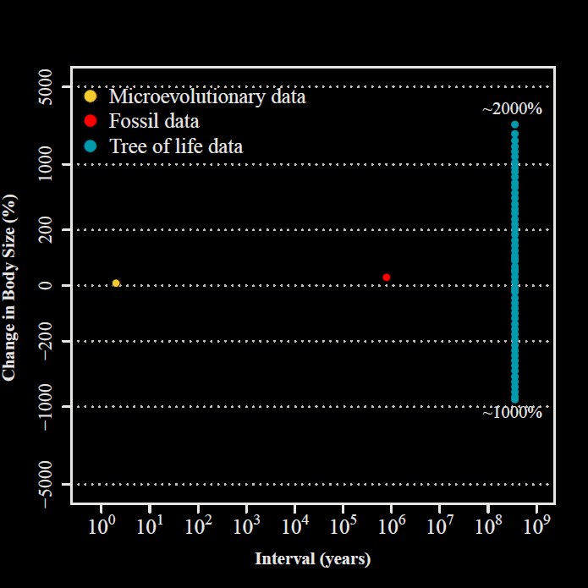
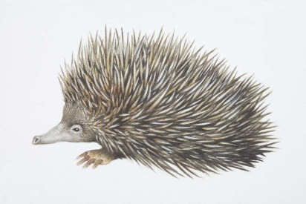
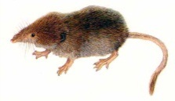
332.4 my

Slide 30
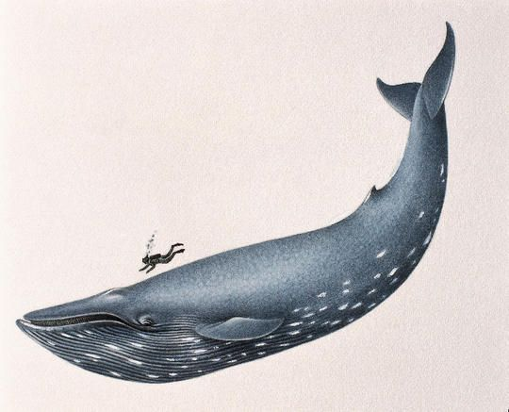
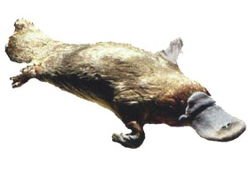
332.4 my
Uyeda et al.,
PNAS, 2011

Slide 31
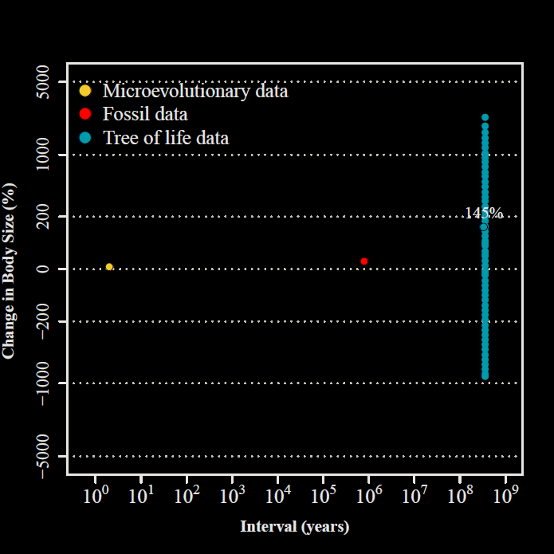
Uyeda et al.,
PNAS, 2011

Slide 32
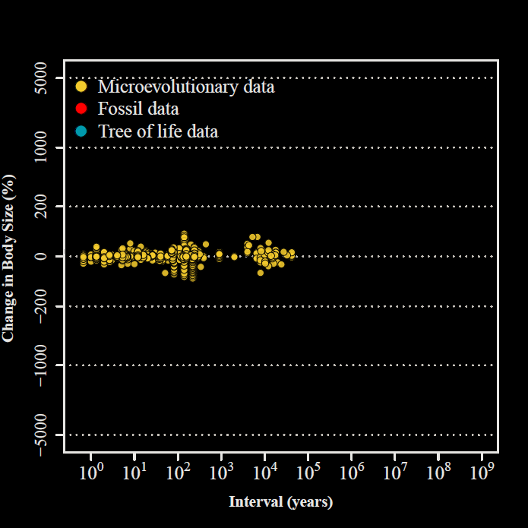
Uyeda et al.,
PNAS, 2011

Slide 33
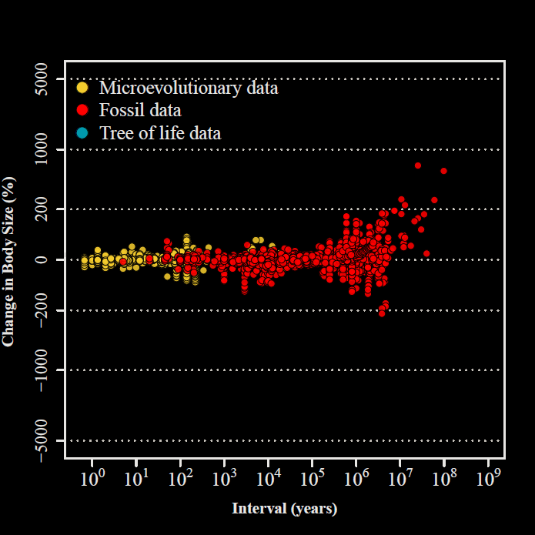
Uyeda et al.,
PNAS, 2011

Slide 34
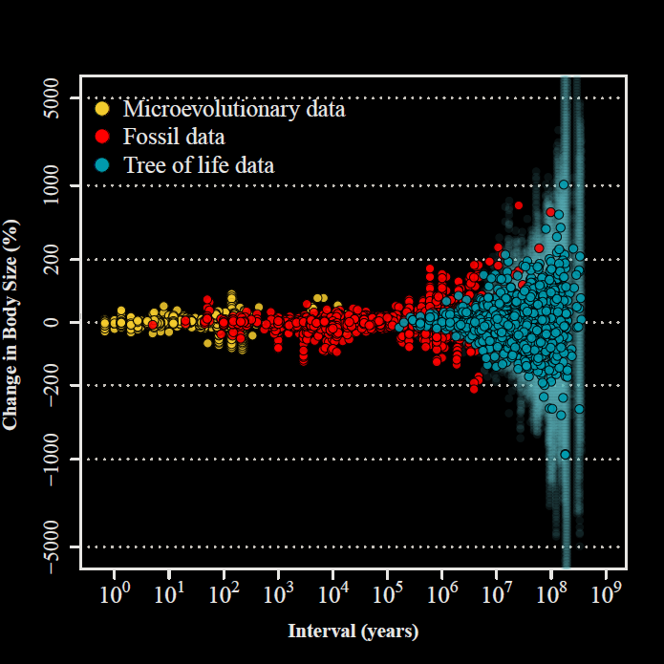

“The Evolutionary Blunderbuss”
Uyeda et al.,
PNAS, 2011

Slide 35
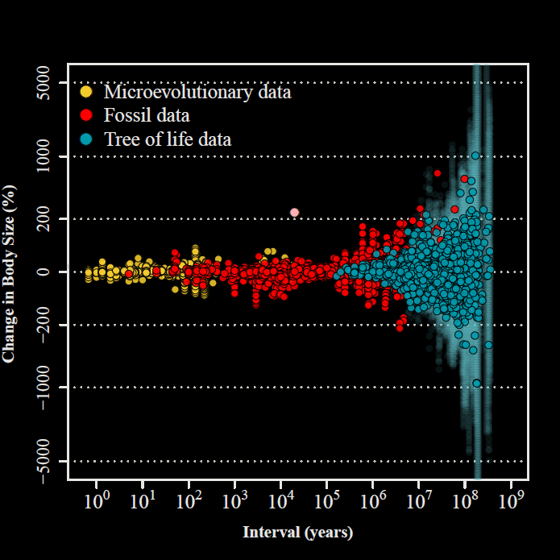
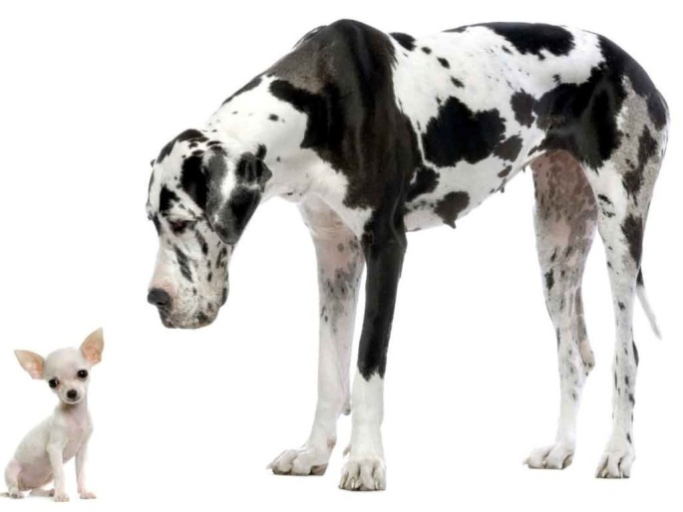
Uyeda et al.,
PNAS, 2011

Slide 36
Some recent proposals

Slide 37
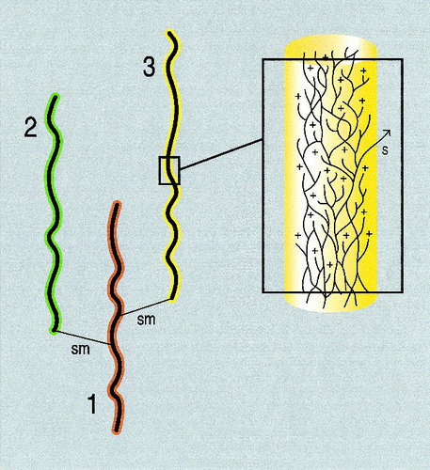
Populations vs. lineages
Eldredge, et al. 2005. The dynamicsof evolutionary stasis. Paleobiology.
Bartoszek et al. 2017. Using the Ornstein-Uhlenbeck process to model the evolution of interacting populations, J. of Theoretical Biology

Slide 38
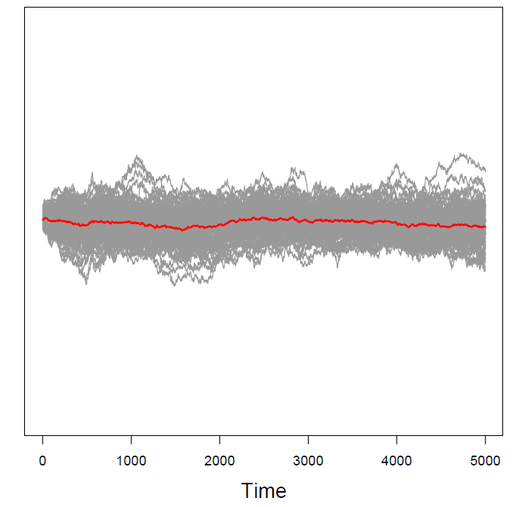
Population means =
How we measure microevolution
Species means = How we measure macroevolution

Slide 39
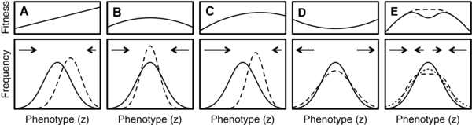
Intraspecific competition
Haller & Hendry. 2014. Solving the paradox of stasis: Squashed stabilizing selection and the limits of detection, Evolution

Slide 40
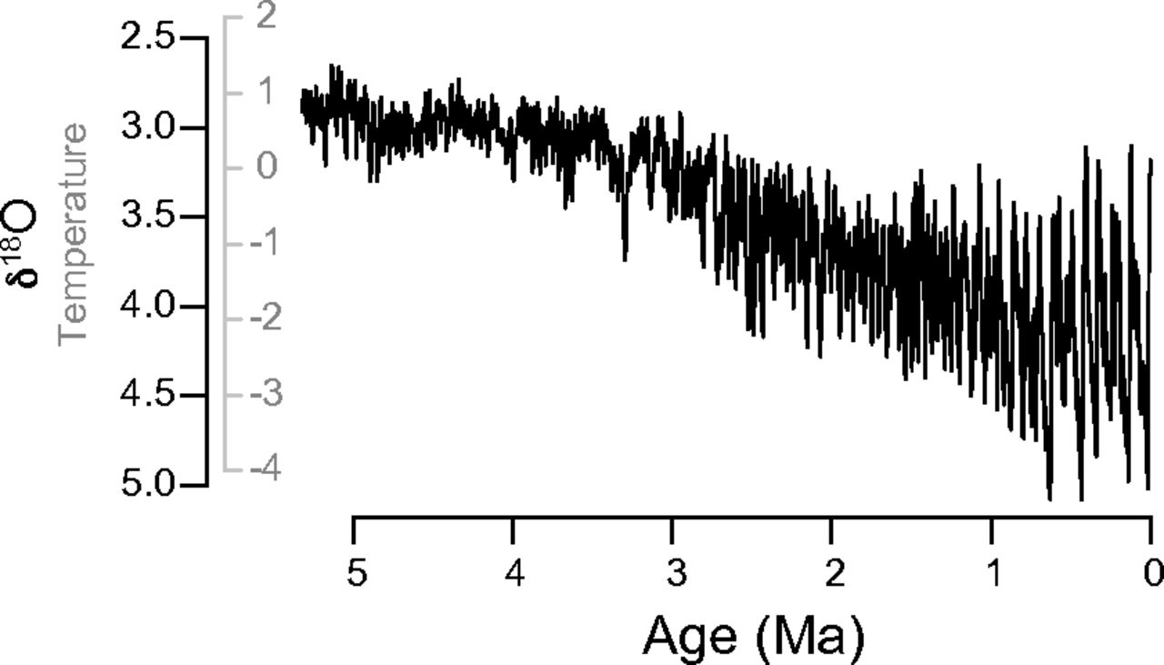
Temperature tracking
Hunt et al. 2015. Simple vs complex models of trait evolution and stasis as a response to environmental change, PNAS

Slide 41
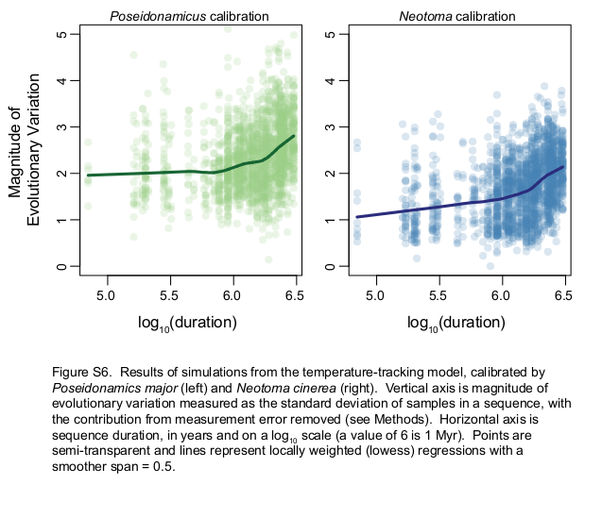

Slide 42
Multivariate genetic constraints

Slide 43
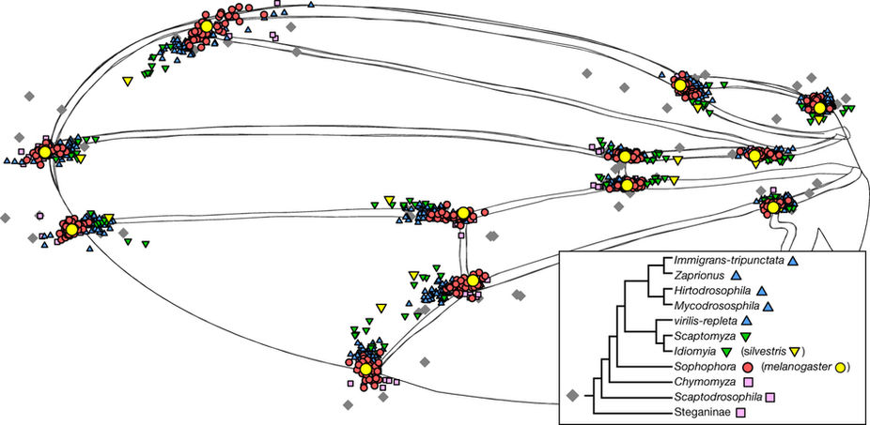
Mutation predicts 40 million years of fly wing evolution Houle et al. 2017, Nature

Slide 44
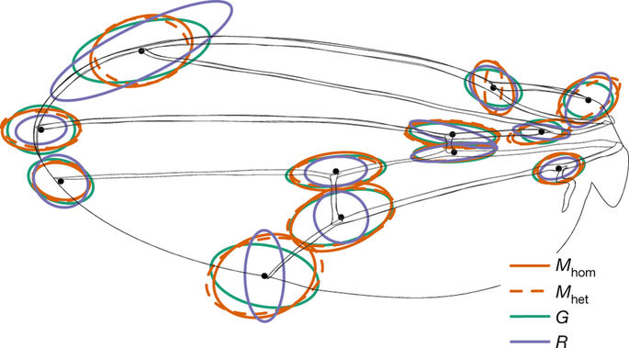
A compelling case of stasis...

Slide 45
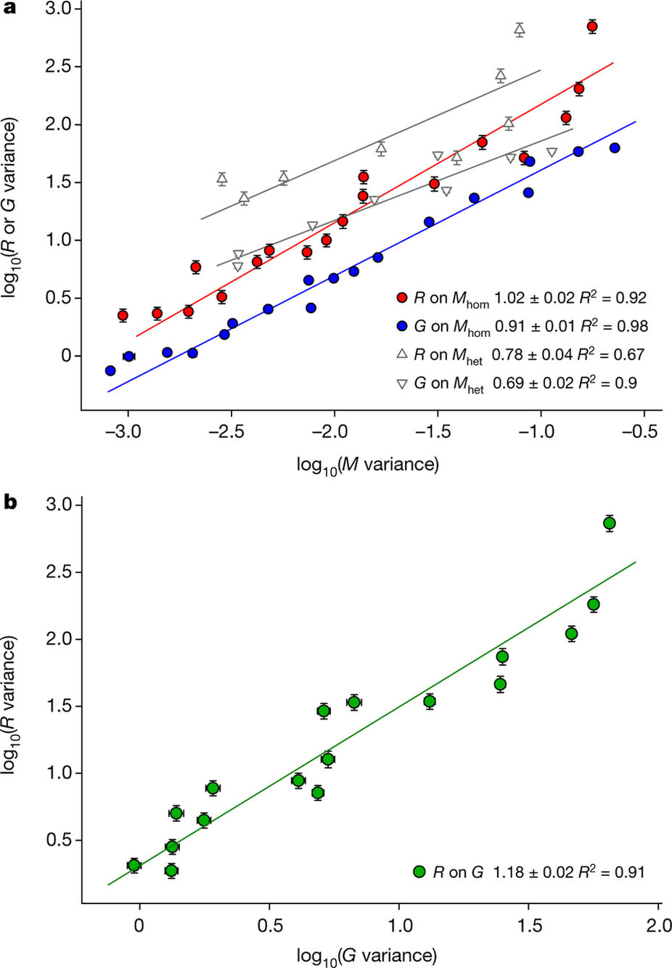
But STRONG isometric relationship between M-matrix and R-matrix (Evo. divergence matrix)

Slide 46
...and G-matrix and R-Matrix

Slide 47
But observed patterns match nothing we expect...
Mutation matrix proportional to macroevolutionary divergence = CONSTRAINTS!
Mutation matrix hugely overestimates the rate of macroevolutionary divergence =
NO CONSTRAINTS!

Slide 48
All of the above?
Most of Hansen & Houle’s criticisms of these ideas still hold
…but it’s hard to imagine that they don’t all contribute

Slide 49
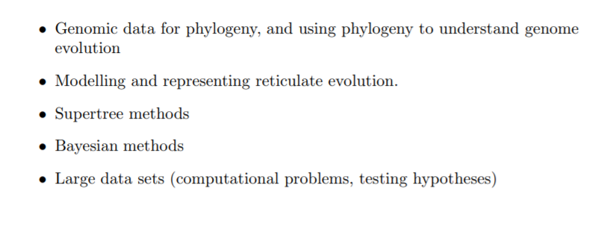

2001 5 yr prediction
Mike Steel

Slide 50
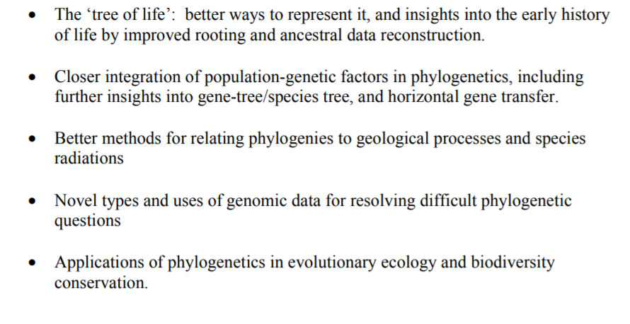
2006 5 yr prediction
Mike Steel

Slide 51
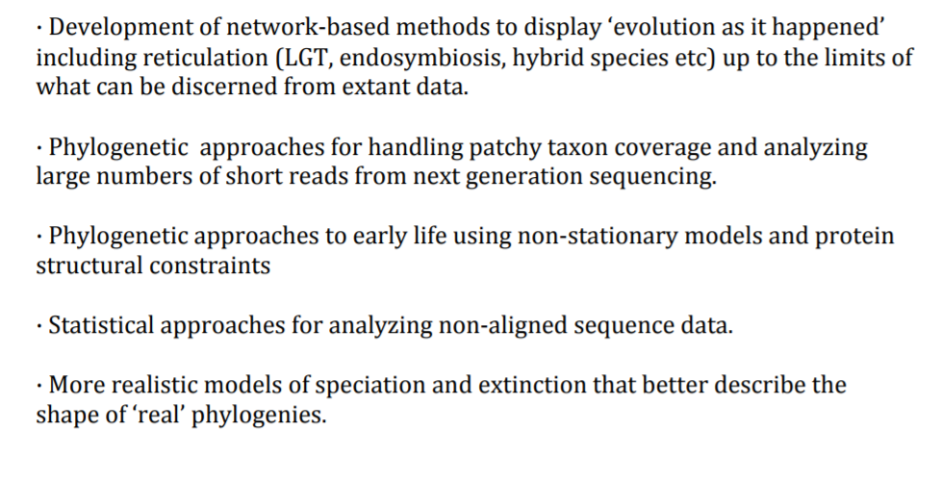
2011 5 yr prediction
Mike Steel

Slide 52
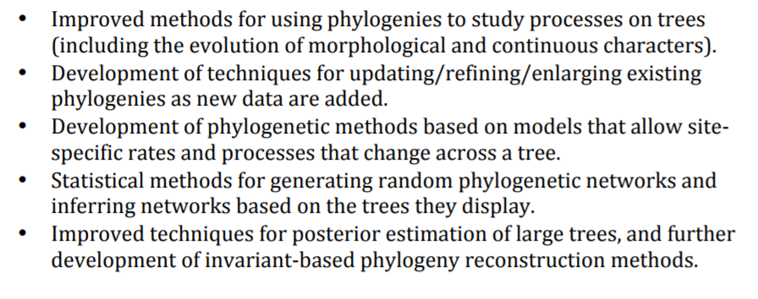
2016 5 yr prediction
Mike Steel

Slide 53
What I don't like about these:
Most of Steel's predictions don't address the questions, but are purely methods
What will be the big advances in terms of the questions we can answer, and with what tools?

Slide 54
Brainstorm: What big questions in macroevolution have we not addressed in this class? What will happen in macroevolution in the next 5-20 years?
What questions do the models we have talked about seem ill-equipped to answer?

Slide 55
Our Tools:
Discrete traits: Continuous-Time Markov Chains
Continuous traits: Gaussian diffusion models (BM/OU etc)
Diversification: Birth-Death Models
Comparative method: Regression models

Slide 56
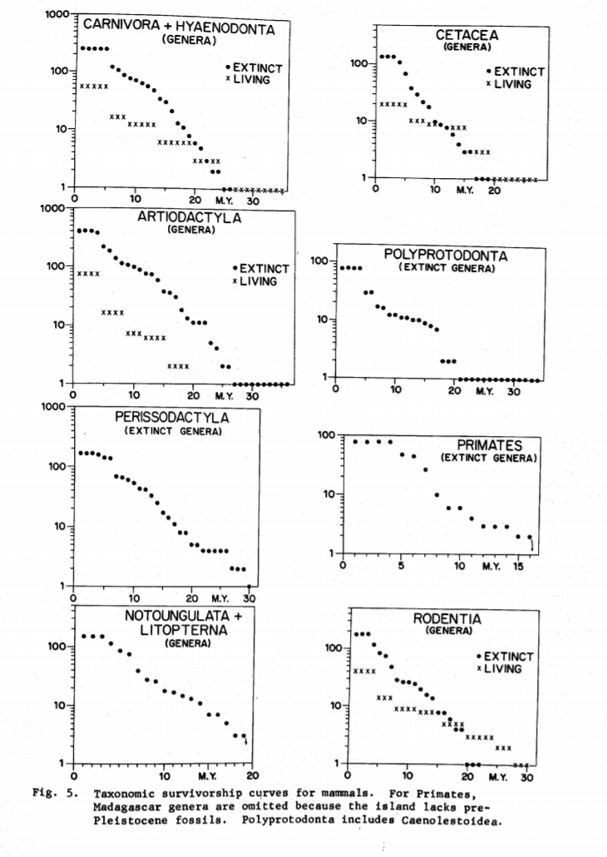

Biotic Interactions
Red Queen - The Law of Constant Extinction
Leigh Van Valen

Slide 57


The Rise and Fall of Species
Remember: Why million year timescales?

Slide 58


Species interactions on trees
Trait evolution models

Slide 59

Species interactions on trees
Trait evolution models

Slide 60


Evo-Devo: The Genotype-Phenotype Map
Simple example: Threshold traits

Slide 62


Biomechanics: Performance as a bridge between phenotypes & macroevolutionary adaptive landscapes

Slide 63


Genomics e.g. phyloGWAS
Genomics broke most of our “good” models...need to figure out how to intelligently see signal through noise

Slide 64
My 5 yr predictions/hopes:
Introduction and expansion of statistical causal inference to macroevolution
Integration of dynamic evolutionary process models into comparative models (demographic processes, sexual selection, coevolution, competition, symbioses, pathogen-host)
Increasing usage of phylogenetic prediction and cross-validation as methods for evaluating models, methods for integrating streaming data building on previous analyses rather than starting from scratch
Elucidation of scaling processes (e.g. gene interactions/networks to phenotypes; populations to species; microevolution to macroevolution)
More customized joint analyses that integrate over uncertainty across many different types of data
Tests and integration of biomechanics, physiological models, and other types of functional models into macroevolutionary adaptive landscapes
Taking the consequences of population variation within lineages seriously for trait evolution (e.g. hemiplasy, polymorphism, etc.)
Improved methods for dealing with multivariate and multitrait datasets.
Increased application of comparative models to analyzing genomic basis of adaptation, e.g phyloGWAS.

